Slide 1
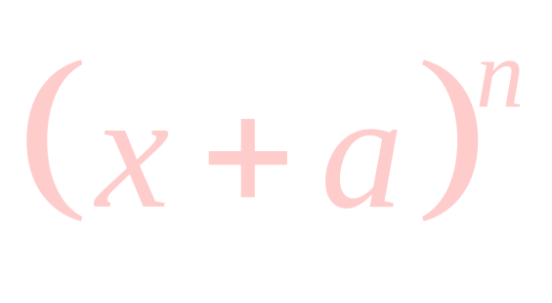
The Binomial
Theorem

Slide 2
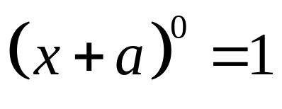
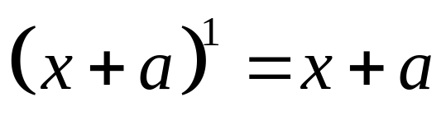
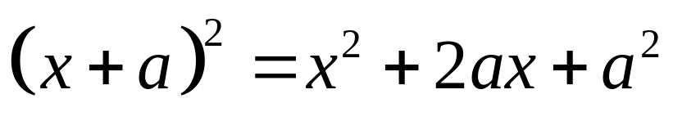
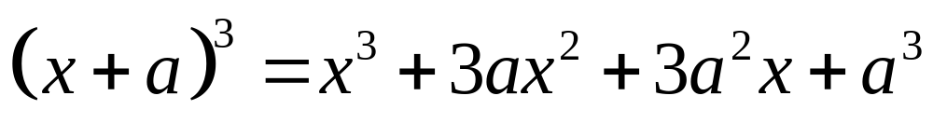
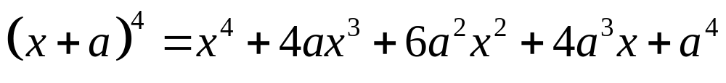
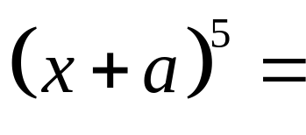
A binomial is a polynomial with two terms such as x + a. Often we need to raise a binomial to a power. In this section we'll explore a way to do just that without lengthy multiplication.
Can you see a pattern?
Can you make a guess what the next one would be?
We can easily see the pattern on the x's and the a's. But what about the coefficients? Make a guess and then as we go we'll see how you did.

Slide 3
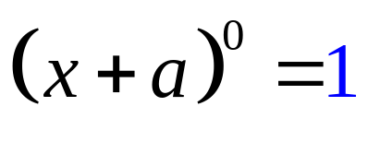
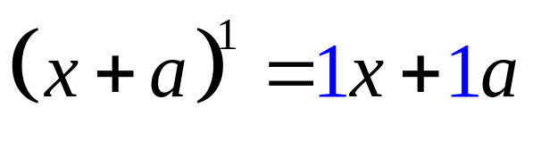
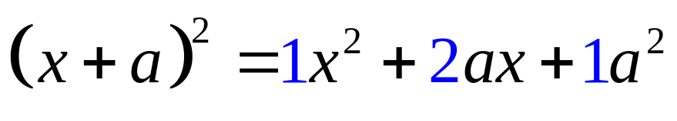
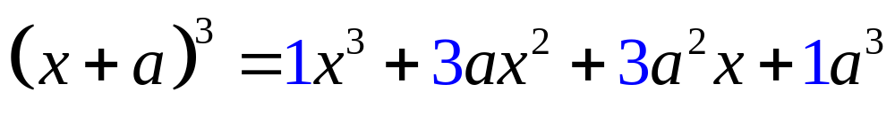
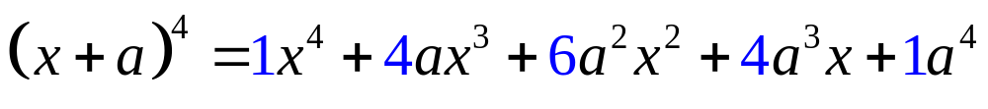
Let's list all of the coefficients on the x's and the a's and look for a pattern.
1
1 1
1 2 1
1 3 3 1
1 4 6 4 1
+
+
+
+
+
+
+
+
+
+
1 5 10 10 5 1
Can you guess the next row?

Slide 4
This is good for lower powers but could get very large. We will introduce some notation to help us and generalise the coefficients with a formula based on what was observed here.
1
1 1
1 2 1
1 3 3 1
1 4 6 4 1
1 5 10 10 5 1
This is called Pascal's Triangle and would give us the coefficients for a binomial expansion of any power if we extended it far enough.

Slide 5
!
!
The Factorial Symbol
0! = 1 1! = 1
n! = n(n-1) · . . . · 3 · 2 · 1
n must be an integer greater than or equal to 2
What this says is if you have a positive integer followed by the factorial symbol you multiply the integer by each integer less than it until you get down to 1.
6! = 6 · 5 · 4 · 3 · 2 · 1 = 720
Your calculator can compute factorials. The ! symbol is under the "math" menu and then "prob".
!
!

Slide 6
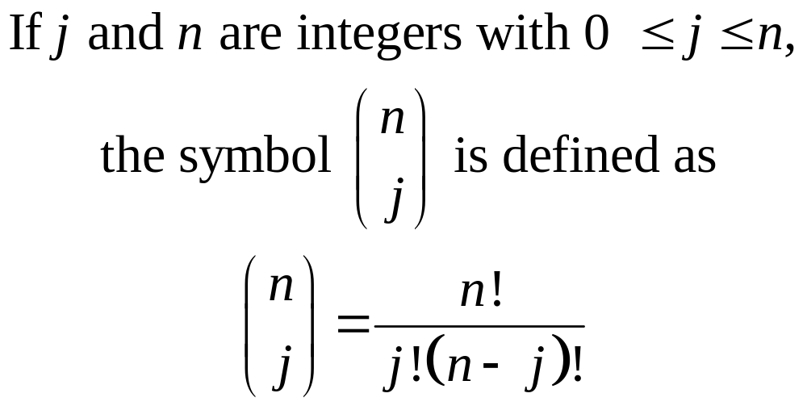
This symbol is read "n taken j at a time"
Your calculator can compute these as well. It is also under the "math" and then "prob" menu and is usually denoted nCr with the C meaning combinations. In probability, there are n things to choose from and you are choosing j of them for various combinations.

Slide 7
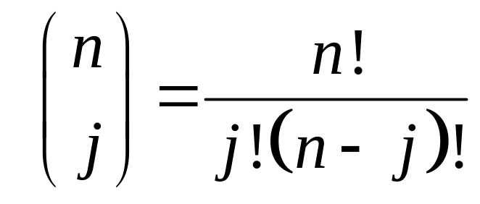
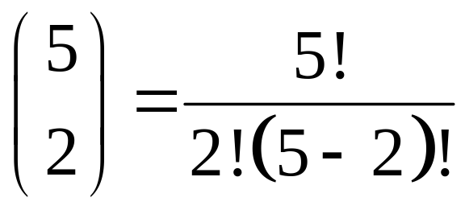
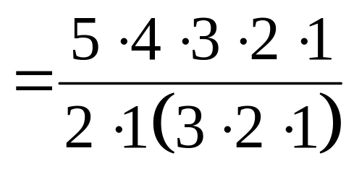
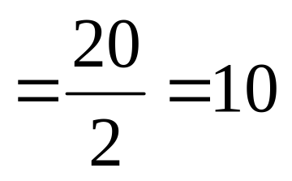
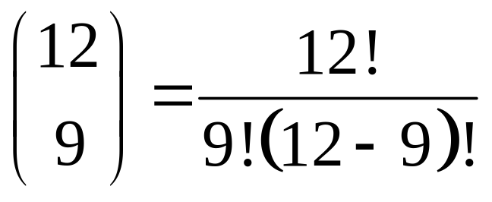
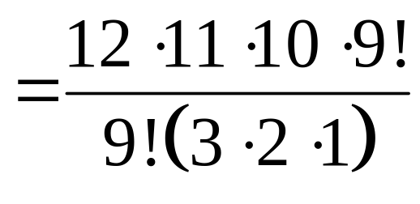
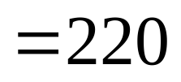
Let's work a couple of these:
2
We are now ready to see how this applies to expanding binomials.

Slide 8
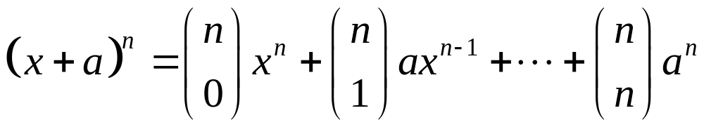
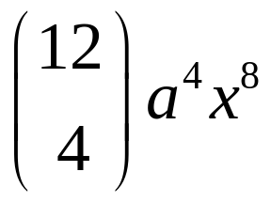

The Binomial Theorem
The x's start out to the nth power and decrease by 1 in power each term. The a's start out to the 0 power and increase by 1 in power each term. The binomial coefficients are found by computing the combination symbol. Also the sum of the powers on a and x is n.
Find the 5th term of (x + a)¹²
1 less than term number
5th term will have a⁴
(power on a is 1 less than term number)
So we'll have x⁸
(sum of two powers is 12)

Slide 9
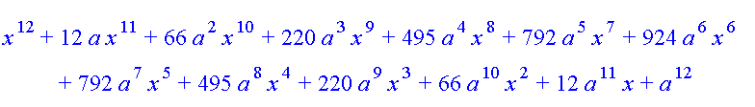
Here is the expansion of (x + a)¹²
…and the 5th term matches the term we obtained!
In this expansion, observe the following:
Powers on a and x add up to power on binomial
a's increase in power as x's decrease in power from term to term.
Powers on a are one less than the term number
Symmetry of coefficients (i.e. 2nd term and 2nd to last term have same coefficients, 3rd & 3rd to last etc.) so once you've reached the middle, you can copy by symmetry rather than compute coefficients.

Slide 10
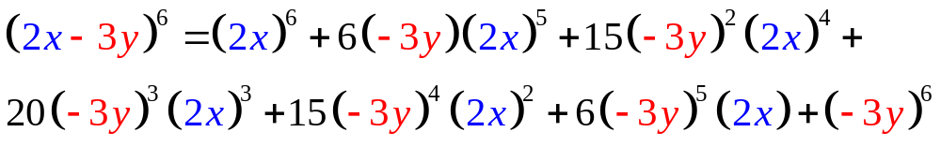
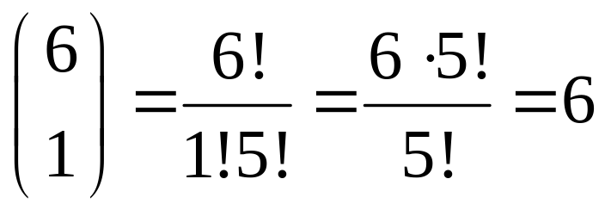
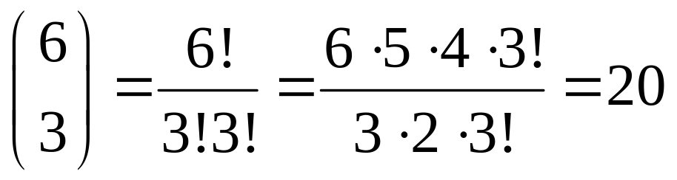
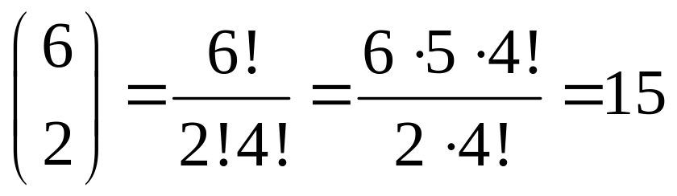
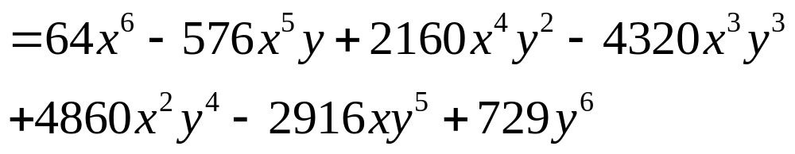
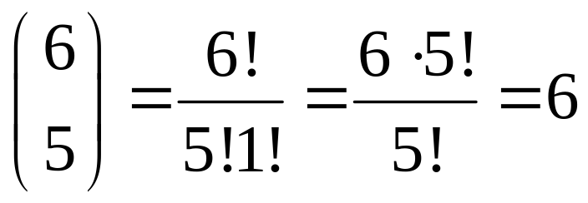
Instead of x we have 2x
Instead of a we have -3y
Let's use what we've learned to expand (2x - 3y)⁶
First let's write out the expansion of the general (x + a)⁶ and then we'll substitute.
6
15
20
15
6
these will be the same
these will be the same
Let's find the coefficient for the second term.
Let's confirm that this is also the coefficient of the 2nd to last term.
This will also be the coefficient of the 3rd to last term.
Let's find the coefficient for the third term.
Now we'll find the coefficient of the 4th term
Now we'll apply this formula to our specific binomial.

Slide 11
Acknowledgement
I wish to thank Shawna Haider from Salt Lake Community College, Utah USA for her hard work in creating this PowerPoint.
www.slcc.edu
Shawna has kindly given permission for this resource to be downloaded from www.mathxtc.com and for it to be modified to suit the Western Australian Mathematics Curriculum.
Stephen Corcoran
Head of Mathematics
St Stephen’s School – Carramar
www.ststephens.wa.edu.au

